Slide 1
BACKTRACK ALGORITHM

Slide 2
BACKTRACKING
Suppose you have to make a series of decisions, among various choices, where
  You don’t have enough information to know what to choose
  Each decision leads to a new set of choices
  Some sequence of choices (possibly more than one) may be a solution to your problem
Backtracking is a logical way of trying out various sequences of decisions until you find the correct one that “works”.

Slide 3

BACKTRACKING
Backtracking is a technique used to solve problems with a large search space, by systematically trying and eliminating possibilities.
A standard example of backtracking would be going through a maze.
  At some point in a maze, you might have two options of which direction to go:
Portion A
Junction
Portion B

Slide 4
BACKTRACKING
One strategy would be to try going through Portion A of the maze.
  If you get stuck before you find your way out, then you "backtrack" to the junction.
At this point in time you know that Portion A will NOT lead you out of the maze,
  so you then start searching in Portion B
Junction
Portion B
Portion A

Slide 5

BACKTRACKING
Clearly, at a single junction you could have even more than 2 choices.
The backtracking strategy says to try each choice, one after the other,
  if you ever get stuck, "backtrack" to the junction and try the next choice.
If you try all choices and never found a way out, then there IS no solution to the maze.
Junction
C
B
A

Slide 6
BACKTRACKING
Backtracking is used to solve problems in which a sequence of objects is chosen from a specified set so that the sequence satisfies some criterion.
Backtracking is a modified depth-first search of a tree.
It is the procedure whereby, after determining that a node can lead to nothing but dead nodes, we go back (“backtrack”) to the node’s parent and proceed with the search on the next child.

Slide 7
BACKTRACK ALGORITHM
Based on depth-first recursive search
Approach
  Tests whether solution has been found
  If found solution, return it
  Else for each choice that can be made
    Make that choice
    Recursive
    If recursion returns a solution, return it
  If no choices remain, return failure
Some times called “search tree”

Slide 8
RECURSIVE BACKTRACKING
(ANOTHER WAY)
Pseudo code for recursive backtracking algorithms
If at a solution, return success
for( every possible choice from current state / node)
Make that choice and take one step along path
Use recursion to solve the problem for the new node / state
If the recursive call succeeds, report the success to the next high level
Back out of the current choice to restore the state at the beginning of the loop.
Report failure

Slide 9
BACKTRACKING (ANIMATION)
dead end
?
dead end
dead end
?
start
?
?
dead end
dead end
?
success!

Slide 10
TERMINOLOGY I
A tree is composed of nodes
There are three kinds of nodes:
The (one) root node
Backtracking can be thought of as searching a tree for a particular “goal” leaf node
Internal nodes
Leaf nodes

Slide 11
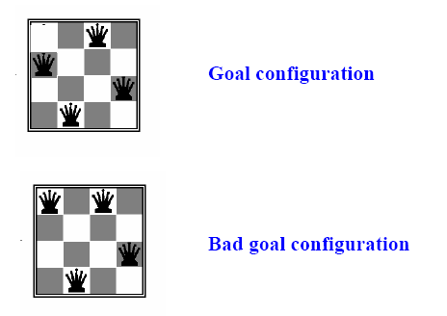
N-QUEENS PROBLEM
Find a configuration of n queens not attacking each other

Slide 12
What is the maximum number of queens that can be placed on an n x n chessboard such that no two attack one another?
The answer is n queens, which gives eight queens for the usual 8x8 board

Slide 13
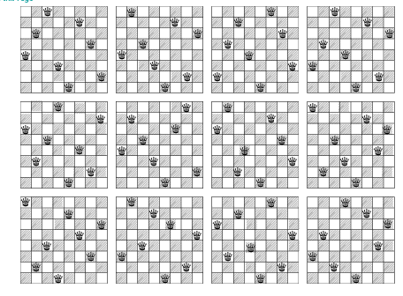
12 UNIQUE SOLUTIONS
8-QUEENS PROBLEM

Slide 14
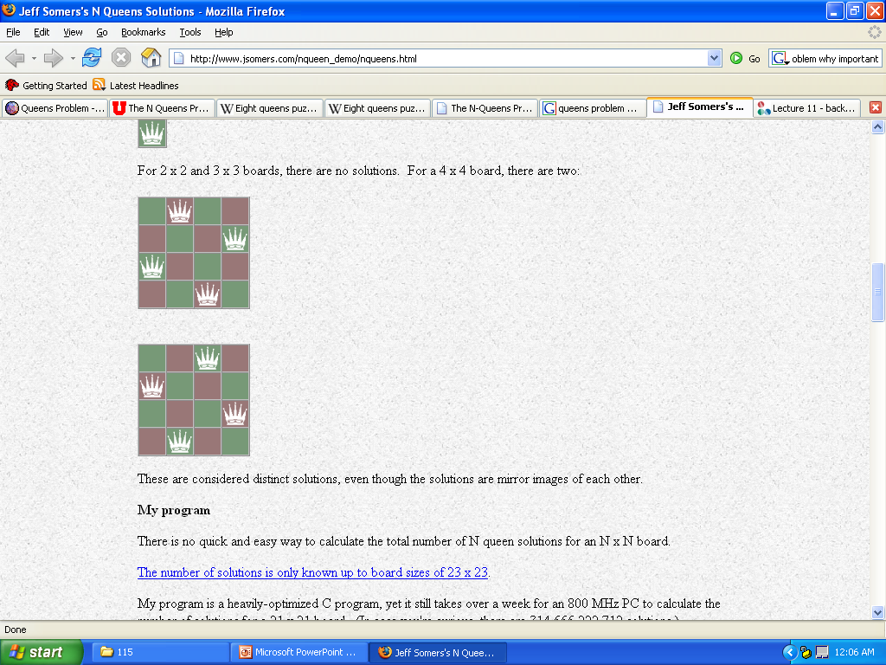
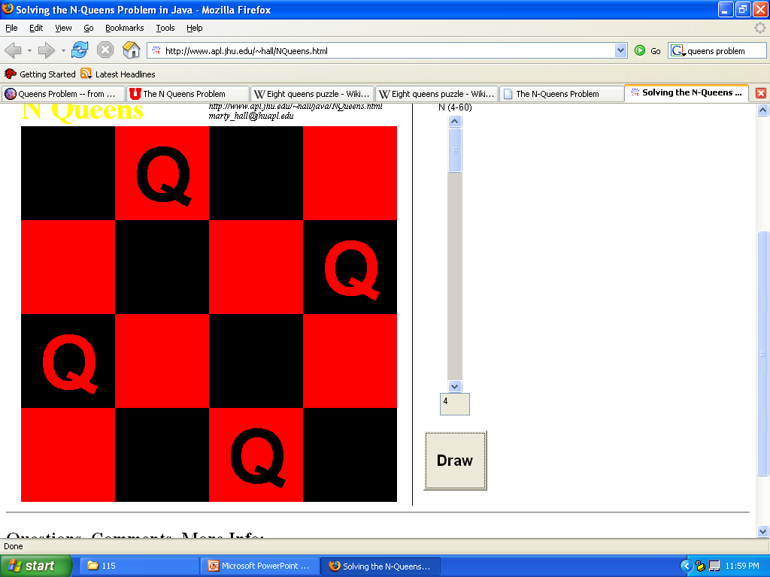
PROBLEMS N < 4
N < 4
Cannot use N Queens
3
2
1

Slide 15
EXAMPLE: THE N-QUEEN PROBLEM
Place n queens on an n by n chess board so that no two of them are on the same row, column, or diagonal

Slide 16
BACKTRACKING IN DECISION TREES
empty board
Q
place 1st queen
Q
Q
Q
place 2nd queen
Q
Q
Q
Q
Q
Q
place 3rd queen
Q
Q
Q
Q
Q
place 4th queen
Q
Q
Q

Slide 17
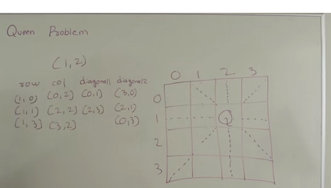

Slide 18
BACKTRACKING EXAMPLE—8 QUEENS PROBLEM
The 8-queens problem is a classical combinatorial problem in which it is required to place eight queens on an 8 x 8 chessboard so no two can attack each other.
A queen can attack another queen if it exists in the same row, column or diagonal as the queen.

Slide 19

BACKTRACKING EXAMPLE—8 QUEENS PROBLEM(CONT…)
This problem can be solved by trying to place the first queen, then the second queen so that it cannot attack the first, and then the third so that it is not conflicting with previously placed queens.

Slide 20

BACKTRACKING EXAMPLE—8 QUEENS PROBLEM(CONT…)
It is an empty 8 x 8 chess board. We have to place the queens in this board.

Slide 21
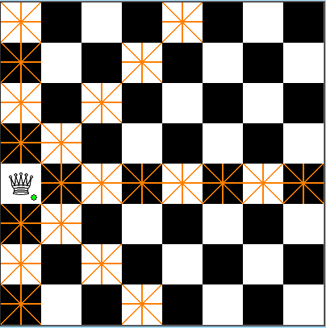
BACKTRACKING EXAMPLE—8 QUEENS PROBLEM(CONT…)
We have placed the first queen on the chess board

Slide 22
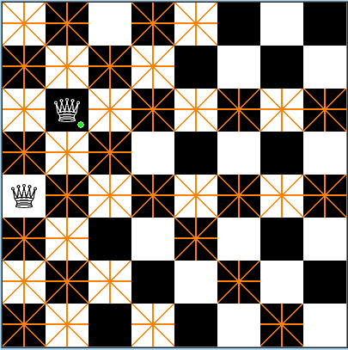
BACKTRACKING EXAMPLE—8 QUEENS PROBLEM(CONT…)
Then we have placed the second queen on the board.
The darken place should not have the queens because they are horizontal, vertical, diagonal to the placed queens.

Slide 23

BACKTRACKING EXAMPLE—8 QUEENS PROBLEM(CONT…)
We have placed the third queen on board.

Slide 24
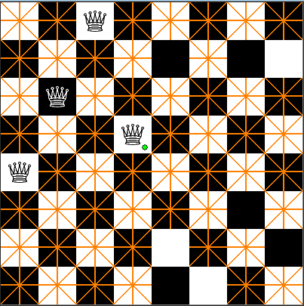
BACKTRACKING EXAMPLE—8 QUEENS PROBLEM(CONT…)
We have placed the 4th queen on the board.
We have placed that in the wrong spot, so we backtrack and change the place of that one.

Slide 25
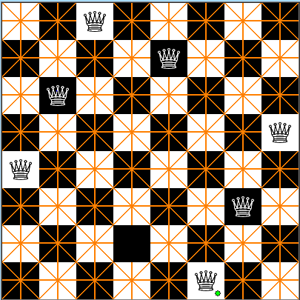
BACKTRACKING EXAMPLE—8 QUEENS PROBLEM(CONT…)
In this way, we have to continue the process untill our is reached ie., we must place 8 queens on the board.

Slide 26
ALGORITHM
Algorithm:
1. Place the queens column wise, start from the left most column
2 If all queens are placed.
  a) return true and print the solution matrix.
3. Else
  a) Try all the rows in the current column.
  b) Check if queen can be placed here safely if yes mark the current cell in solution matrix as 1 and try to solve the rest of the problem recursively.
  c) If placing the queen in above step leads to the solution return true.
  d) If placing the queen in above step does not lead to the solution , BACKTRACK, mark the current cell in solution matrix as 0 and return false.
4. If all the rows are tried and nothing worked, return false and print NO SOLUTION.

Slide 27

GRAPH COLORING PROBLEM

Slide 28


Slide 29
FULL EXAMPLE: MAP COLORING
The Four Color Theorem states that any map on a plane can be colored with no more than four colors, so that no two countries with a common border are the same color
For most maps, finding a legal coloring is easy
For some maps, it can be fairly difficult to find a legal coloring

Slide 30
GRAPH COLOURING ALGO
If all colors are assigned, print vertex assigned colors
Else
a. Trying all possible colors, assign a color to the vertex
b. If color assignment is possible, recursivelty assign colors to next vertices
c. If color assignment is not possible, de-assign color, return False

Slide 31
DATA STRUCTURES
We need a data structure that is easy to work with, and supports:
  Setting a color for each country
  For each country, finding all adjacent countries
We can do this with two arrays
  An array of “colors”, where countryColor[i] is the color of the i^{th} country
  A ragged array of adjacent countries, where map[i][j] is the j^{th} country adjacent to country i
    Example: map[5][3]==8 means the 3th country adjacent to country 5 is country 8

Slide 32
CREATING THE MAP
0
1
4
int map[][];
createMap() {
map[0] { 1, 4, 2, 5 };
map[1] { 0, 4, 6, 5 };
map[2] { 0, 4, 3, 6, 5 };
map[3] { 2, 4, 6 };
map[4] { 0, 1, 6, 3, 2 };
map[5] { 2, 6, 1, 0 };
map[6] { 2, 3, 4, 1, 5 };
}
2
3
6
5

Slide 33
SETTING THE INITIAL COLORS
int NONE = 0, RED = 1,YELLOW = 2, GREEN = 3, BLUE = 4;
int mapColors[] = { NONE, NONE, NONE, NONE,
NONE, NONE, NONE };

Slide 34
THE MAIN PROGRAM
(The name of the enclosing class is ColoredMap)
void main(String args[]) {
  createMap();
  boolean result = explore(0, RED);
  print(result);
}

Slide 35
THE BACKTRACKING METHOD
boolean explore(int country, int color) {
  if (country >= map.length) return true;
  if (okToColor(country, color)) {
    mapColors[country] = color;
    for (int i = RED; i <= BLUE; i++) {
      if (explore(country + 1, i)) return true;
    }
  }
  return false;
}

Slide 36
CHECKING IF A COLOR CAN BE USED
boolean okToColor(int country, int color) {
  for (int i = 0; i < map[country].length; i++) {
    int ithAdjCountry = map[country][i];
    if (mapColors[ithAdjCountry] == color) {
      return false;
    }
  }
  return true;
}

Slide 37
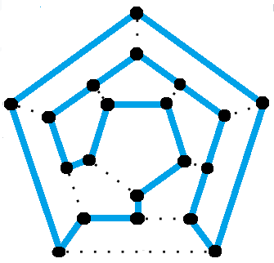
HAMILTONIAN CYCLE
A Hamiltonian Cycle is a cycle that visits each node exactly once.
A loop is just an edge that joins a node to itself; so a Hamiltonian cycle is a path traveling from a point back to itself, visiting every node en route.
f a graph with more than one node (i.e. a non-singleton graph) has a Hamiltonian cycle, we call it a Hamiltonian graph.

Slide 38
HISTORY OF THE HAMILTONIAN CYCLE
The Hamiltonian cycle was named after Sir William Rowan Hamilton who, in 1857, invented a puzzle-game which involved hunting for a Hamiltonian cycle. The game, called the Icosian game, was distributed as a dodecahedron graph with a hole at each vertex. To solve the puzzle or win the game one had to use pegs and string to find the Hamiltonian cycle — a closed loop that visited every hole exactly once.

Slide 39
EXAMPLES OF HAMILTONIAN GRAPHS
Every complete graph with more than two vertices is a Hamiltonian graph. This follows from the definition of a complete graph: an undirected, simple graph such that every pair of nodes is connected by a unique edge.
The graph of every platonic solid is a Hamiltonian graph. So the graph of a cube, a tetrahedron, an octahedron, or an icosahedron are all Hamiltonian graphs with Hamiltonian cycles.
A graph with n vertices (where n > 3) is Hamiltonian if the sum of the degrees of every pair of non-adjacent vertices is n or greater. This is known as Ore’s theorem.

Slide 40

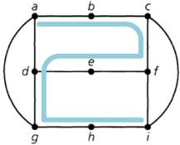
Hamiltonian Cycle: If G = (V, E) is a graph or multi-graph with |V|>=3, we say that G has a Hamiltonian cycle if there is a cycle in G that contains every vertex in V.
Hamiltonian Path: A Hamiltonian path is a path (and not a cycle) in G that contains each vertex. It is possible, however, for a graph to have a Hamiltonian path without having a Hamiltonian cycle.
Hamiltonian path 
Hamiltonian cycle 

Slide 41

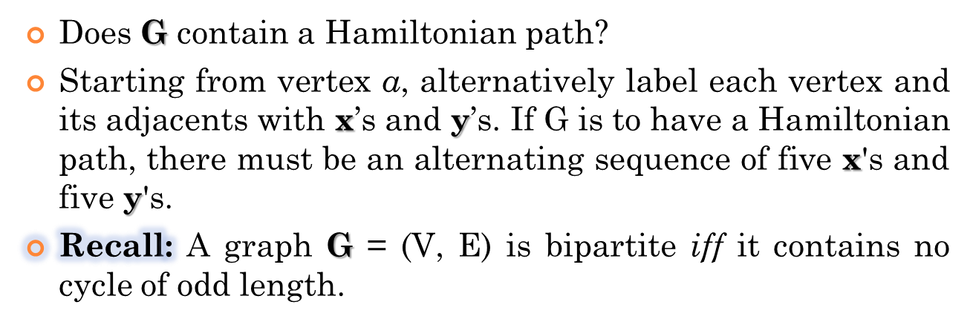
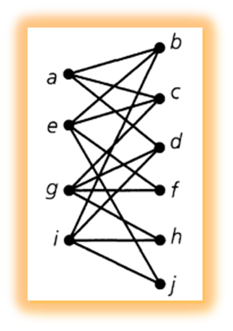
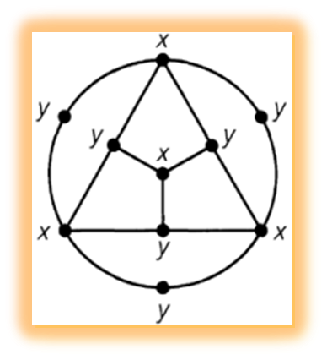
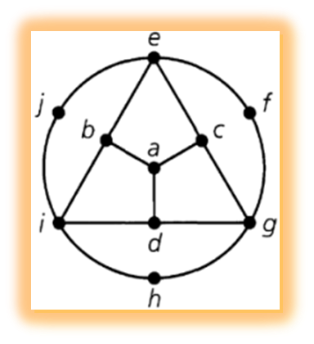
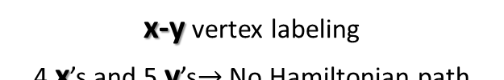

G (no cycle of odd length)
G is, in fact, a bipartite graph

